Slide 1
IOT Platform
Group 5

Slide 2
Introduction
The rise of Internet of Things (IoT) has enabled us to connect and collect data from an ever-growing number of devices and sensors. However, managing and analyzing this data can be a complex and time-consuming task, which is where our IoT platform comes in.
We have built a scalable solution for deploying and managing large numbers of IoT based applications.

Slide 3
With our Platform, you can…
Connect to and collect data from plethora of sensors
Deploy multiple applications
Compile services to create workflows
Schedule deployment
Get authentication through LDAP
Perform Fault Tolerant and Reliable deployment
Easily connect to deployed applications and avail it’s services
Also avail other platform services for analyses and notification

Slide 4
Introduction (Contd…)
Techstack
Comprises of 7 subsystems
Bootstrapper
Application Controller
Scheduler
Node Manager
Load Balancer
Deployer
Sensor Manager
Monitoring & Fault Tolerance
Inter-Module Communication | Kafka
Containerization, abstraction | Docker
Virtual Machines | Azure
DataBase | MongoDB
Other File Storage | Azure blob storage
Authentication | LDAP

Slide 5
Communication Diagram

Slide 6
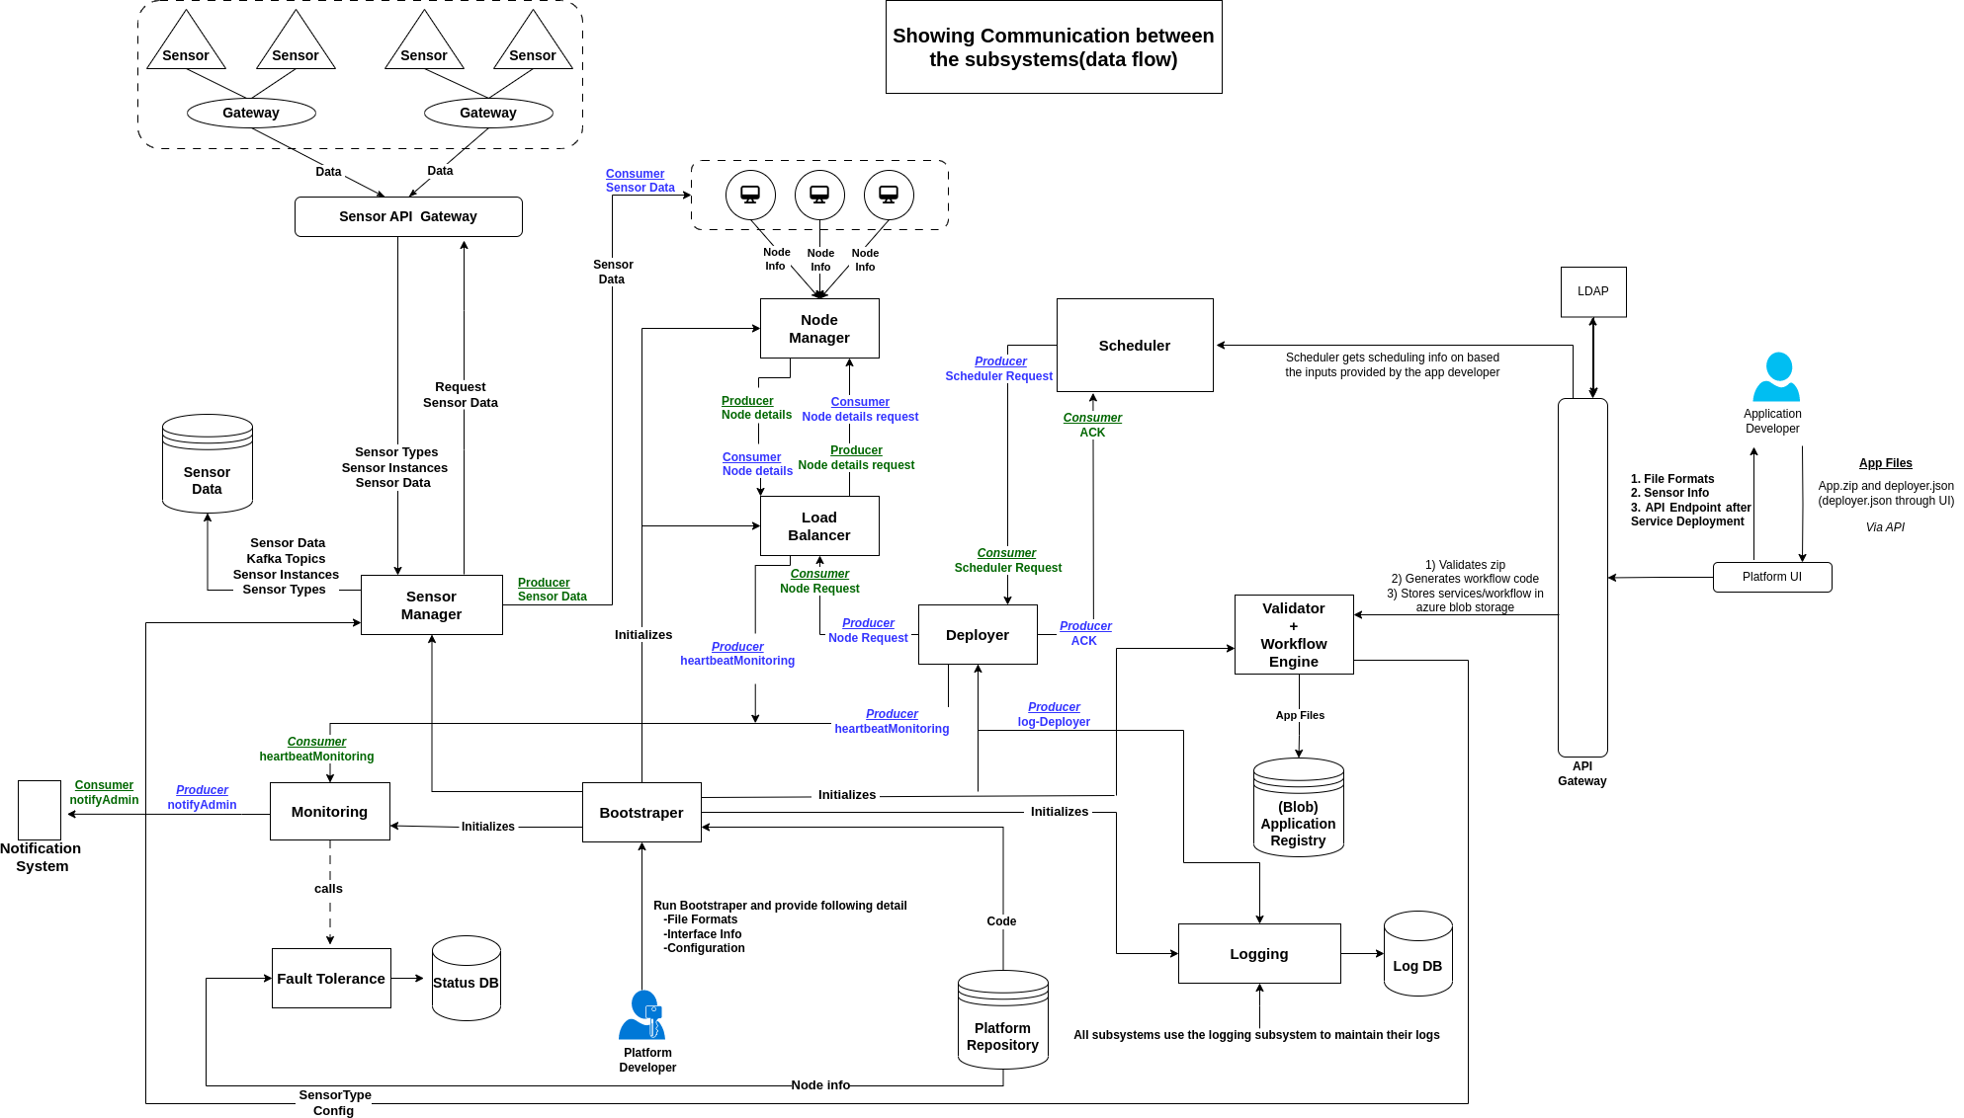
CentralKafka

Slide 7
CentralKafka

Slide 8
CentralKafka

Slide 9
CentralKafka

Slide 10
CentralKafka

Slide 11
CentralKafka

Slide 12
CentralKafka

Slide 13
CentralKafka

Slide 14
CentralKafka

Slide 15
CentralKafka

Slide 16
App Model

Slide 17
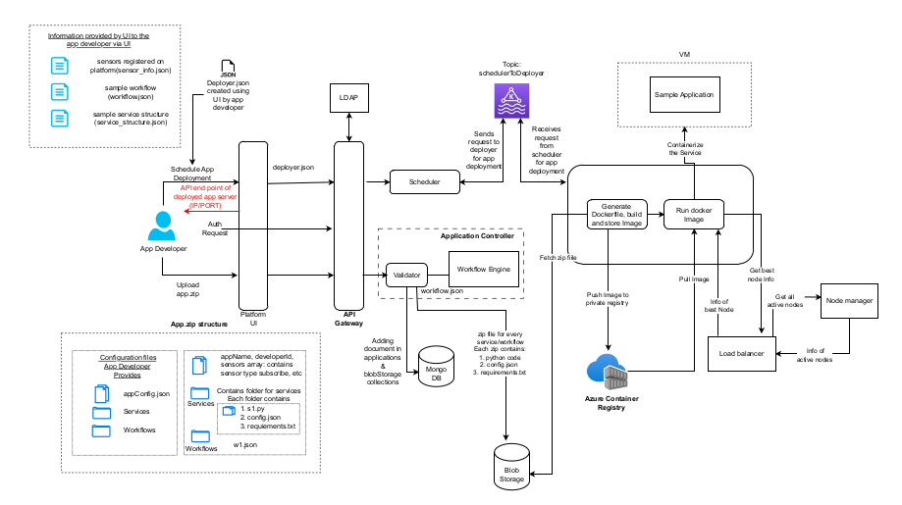
App Model

Slide 18
Contracts

Slide 19
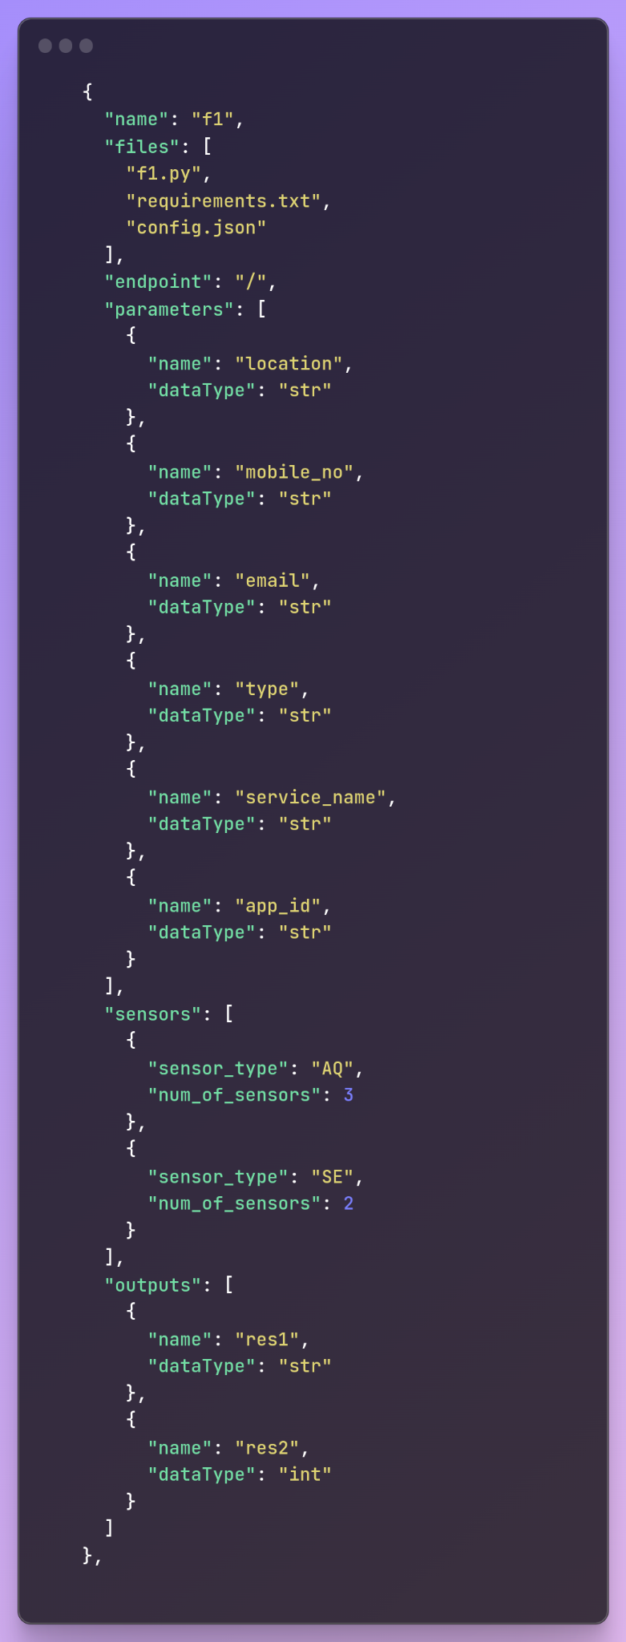
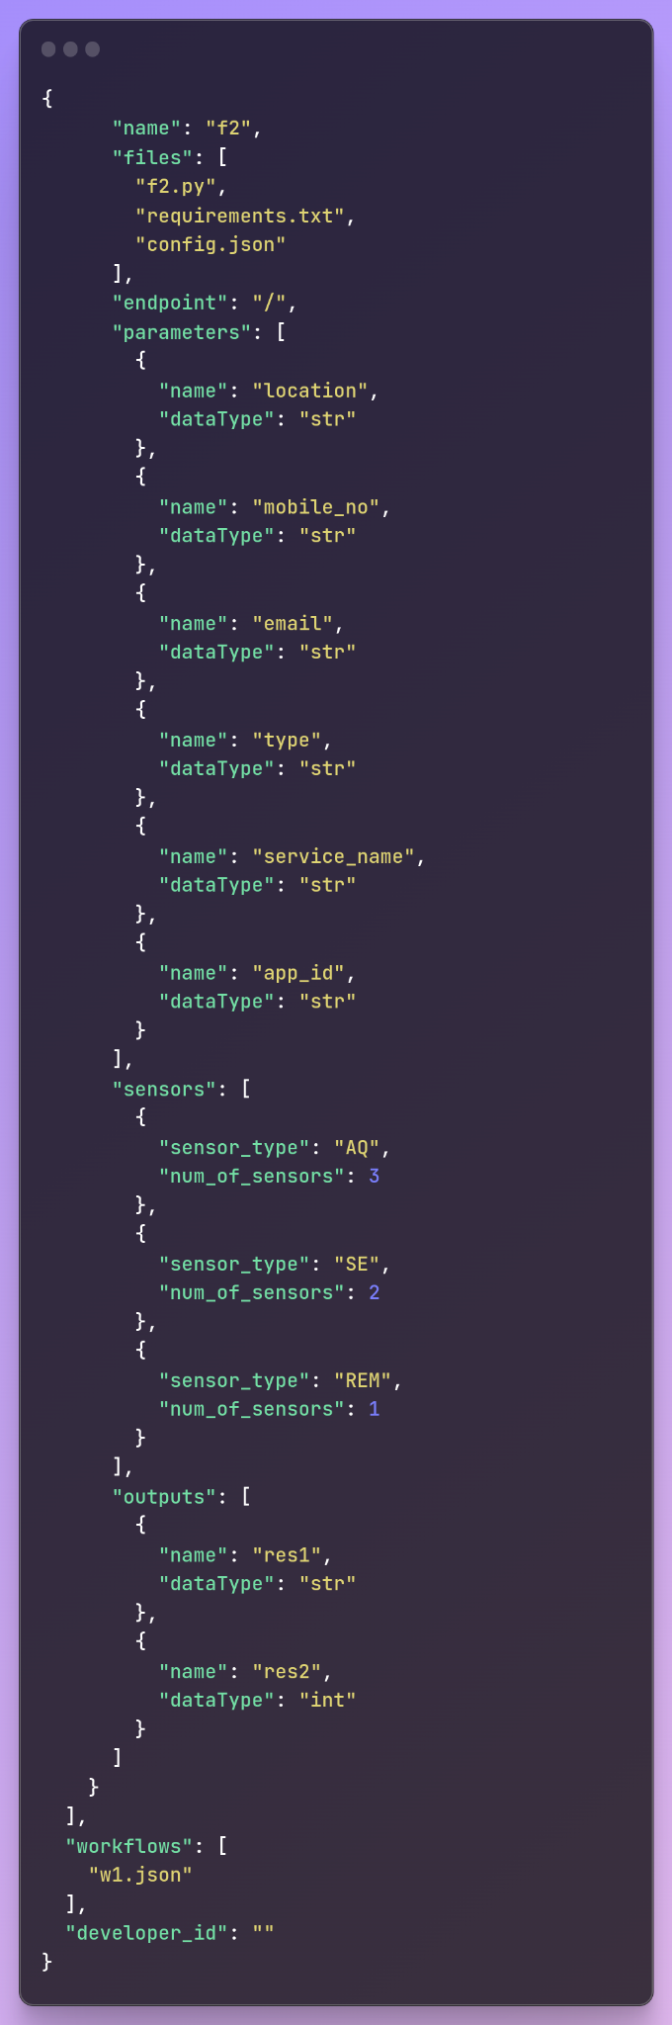
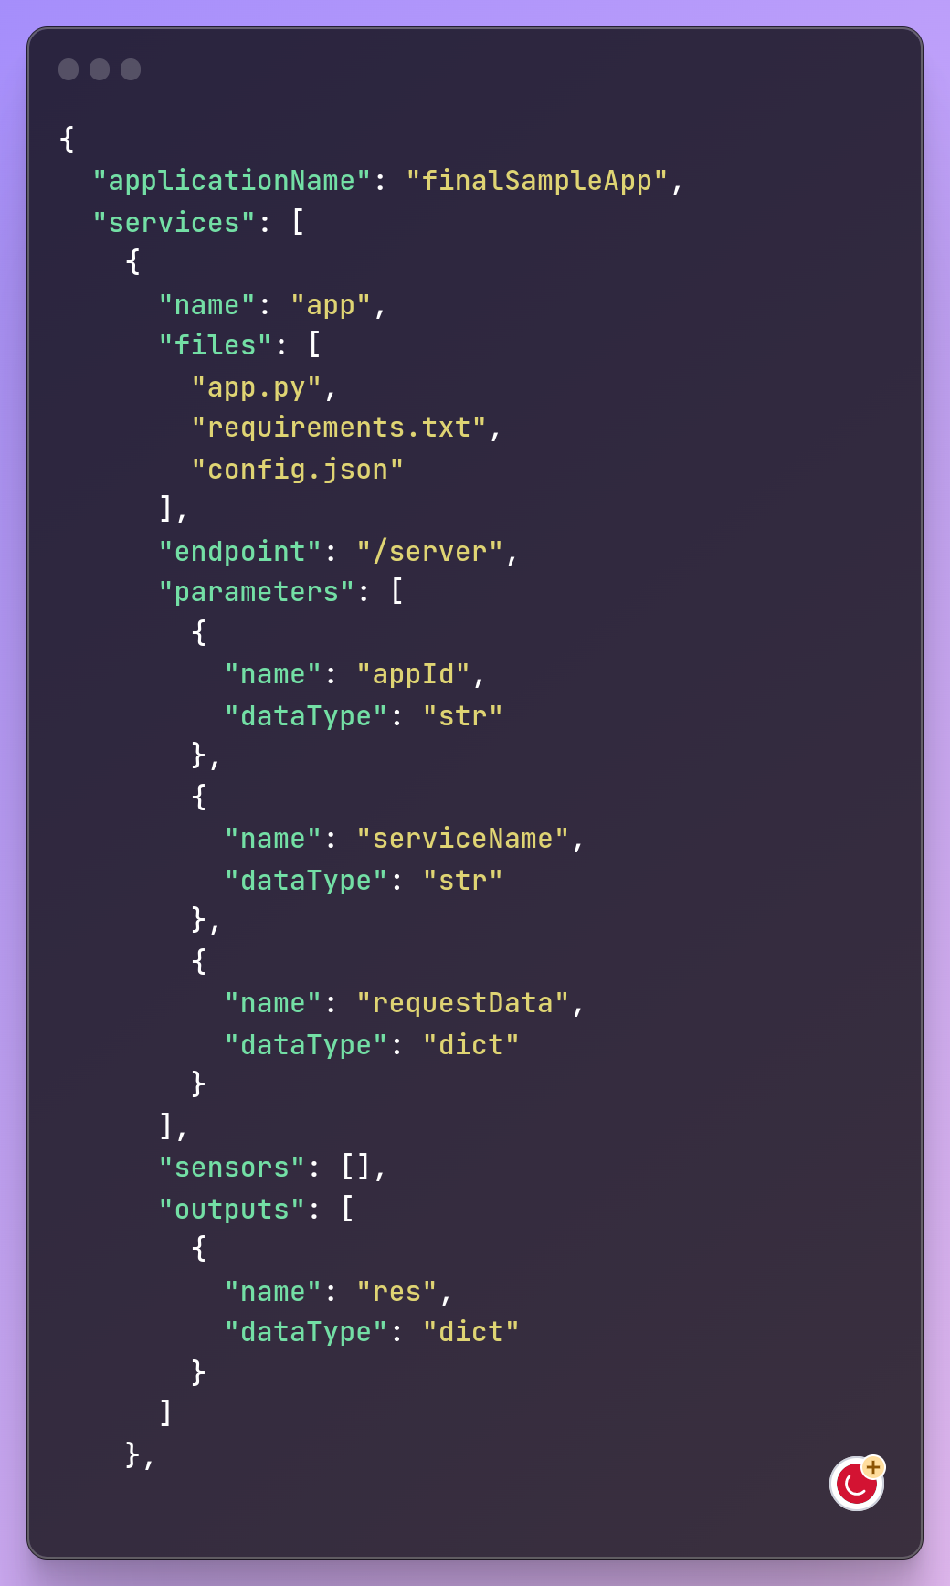
App Config

Slide 20
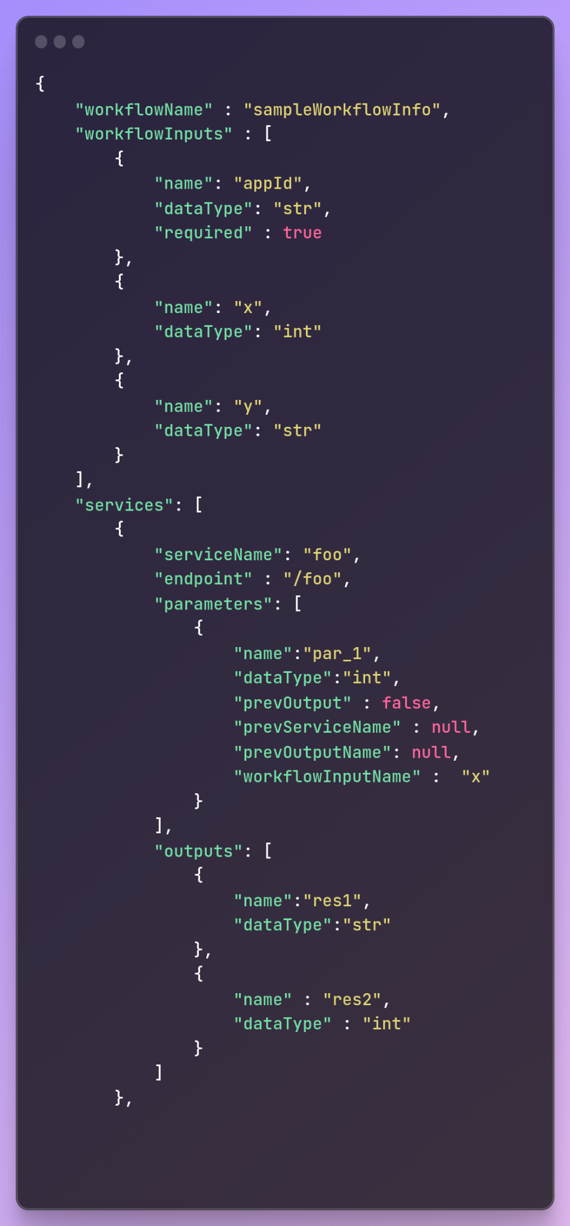
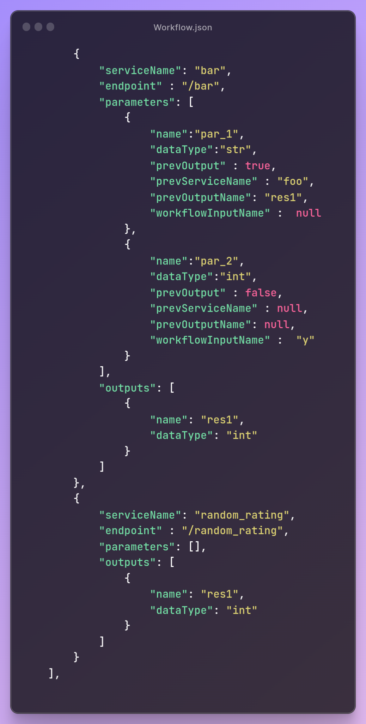
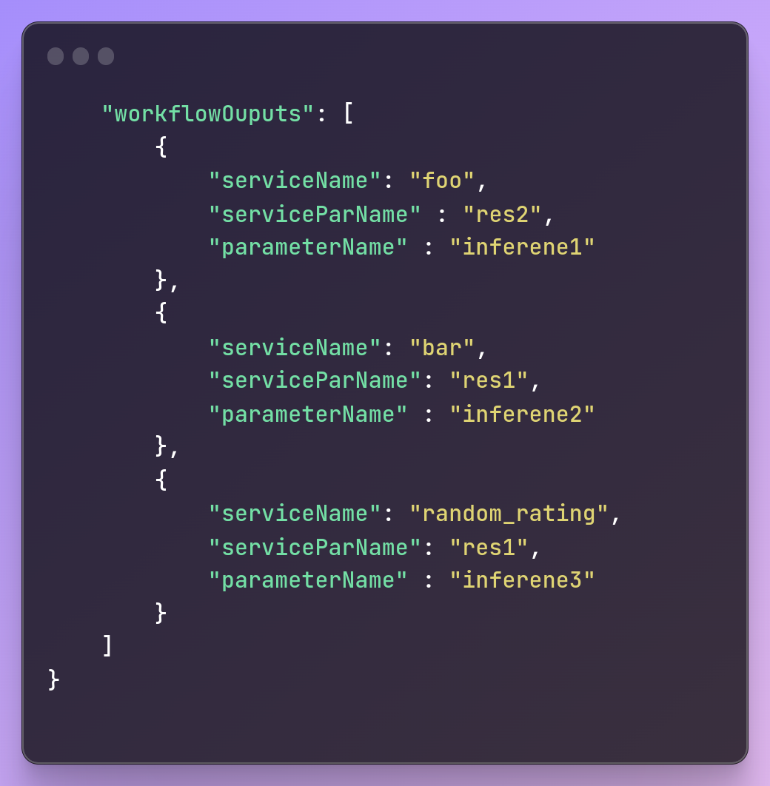
Workflow

Slide 21
Thank You!
Any Questions?

